Slide 1



FINAL DEFENSE
Barangay Vehicle Management System
A web-based fleet readiness and maintenance system for barangay emergency vehicles
Barangay VMS · 2026
Notes:
Introduce the project and the team. One sentence on what VMS is: it keeps a barangay's ambulances, fire trucks and rescue boats ready to respond.

Slide 2
Background of the study
Emergency response depends on vehicles that are ready.
Ambulances
Barangays operate ambulances, fire trucks and rescue boats.
Readiness depends on timely reporting, repair and checking of every problem.
Without a shared system, this work lives in memory, chat messages and paper.
Fire trucks
Rescue boats
Notes:
Set the context: the vehicles are only useful if they are ready, and readiness is a maintenance and accountability problem.

Slide 3




Statement of the problem
No single view of readiness
Problems get lost
Unclear responsibility
Upkeep is reactive
Staff cannot tell at a glance which vehicles can respond right now.
Issues are reported informally, with no owner and no follow-up.
It is hard to prove who reported, approved, repaired and checked a fix.
Preventive maintenance is not planned or tracked consistently.
How can a barangay keep its emergency vehicles ready, and prove it?
Notes:
Four problems, each answered later by a module in the system.

Slide 4
Objectives of the study
1
Track vehicles, locations, conditions and readiness checks.
GENERAL OBJECTIVE
Design, develop and test a web-based system that keeps a barangay's emergency vehicles ready to respond.
2
Run a controlled maintenance ticket lifecycle with approval and independent verification.
3
Enforce role-based access with each barangay's data kept separate.
4
Plan preventive maintenance and provide reports and an audit trail.
Notes:
One general objective and four specific objectives. The results slide maps each one to evidence.

Slide 5


Scope and delimitations
Within scope
Outside scope
Land and water vehicle registry
Live dispatch and GPS tracking
Readiness checks and condition monitoring
Document-compliance tracking
Issue reports and maintenance tickets
Preventive maintenance schedules
Mileage-based service planning
Vehicle location hubs and map
Email verification and self-service password reset (future work)
Reports, notifications and activity log
Four roles, one barangay each
Notes:
The system tracks availability, not live dispatch. Keep the limits explicit so they are not mistaken for omissions.

Slide 6




Significance of the study
Barangay officials
Custodians
See fleet readiness and approve work with a complete record.
Know exactly which reports, tickets and verifications are theirs.
Maintenance personnel
Residents
Receive clear work orders and record repairs and parts used.
Rely on emergency vehicles that are ready when needed.
Notes:
Who benefits and how.

Slide 7





How the system was developed
Requirements and role analysis
Core build
Production-readiness audit
Stabilization review
Senior review and capability audit
Roles, workflow and scope defined and written down.
Fleet, issues, tickets, schedules, maps and reports.
Removed verification and schedule bypasses.
Hardened registration approval and boundary review.
Closed self-verification gaps; added fleet readiness impact.
Each audit pass is documented in the project's review documents.
Notes:
Development was iterative. Between the build and now, five written reviews found and closed real gaps.

Slide 8
System architecture
Admin
Custodian
Maintenance Personnel
Super Admin
Client: React 19 single-page app (Vite)
Role-based workspace
Super Admin portal
Public pages: login, register
Leaflet maps
HTTPS · JSON · Sanctum bearer token
API: Laravel 13 (PHP 8.3), 165 endpoints
Valid token
Active account
Super Admin scope
Permission ability
Barangay scope
Relational database
File storage
SQLite (local) · PostgreSQL (deployed) · 38 tables
Supabase Storage (S3-compatible): photos, attachments
Notes:
Every request passes the same middleware chain. Multi-tenancy: every record carries a barangay id and queries are scoped automatically.

Slide 9








Technology stack
React 19
Vite 8
Leaflet
Laravel 13
Single-page interface
Build and dev server
Maps and boundaries
REST API
PHP 8.3
Sanctum
PostgreSQL / SQLite
Supabase Storage
Server language
Token authentication
Relational data
Photos and files
Notes:
Mainstream, well-documented tools: easy to maintain after turnover.

Slide 10
Roles and access
Capability | Admin | Custodian | Maintenance Personnel | Super Admin
Approve staff accounts | ✓ | – | – | ✓ first Admin
Report a vehicle issue | – | ✓ | ✓ | –
Propose a maintenance ticket | – | ✓ | – | –
Approve and assign a ticket | ✓ | – | – | –
Log repairs and parts used | – | – | ✓ | –
Verify a completed repair | – | ✓ | – | –
Book / approve schedules | approve | book | complete | –
Manage barangays and codes | – | – | – | ✓
A user can hold more than one role, but can never verify their own repair.
Notes:
Verification belongs only to the assigned Custodian. Admin is not a fallback verifier.

Slide 11
Maintenance ticket lifecycle
Pending Approval
Active
For Verification
Closed
Custodian proposes
Mechanic repairs
Awaiting Custodian
Verified
Admin approves and assigns
Last repair logged (automatic)
Custodian approves
Decline
Disapprove
The Admin declines a proposal with a reason. It stays visible as Declined and can be undeclined, then approved.
The Custodian disapproves a repair with a reason. The ticket returns to Active and the mechanic is notified.
Notes:
Every ticket starts as a Custodian proposal. Admin approval makes it live. The mechanic logging the last repair moves it to verification automatically. Only the assigned Custodian can verify.

Slide 12
Database design
Tenancy and users
Fleet
Repair workflow
Preventive care
Support
provinces
vehicles
vehicle_issue_reports
vehicle_condition_checks
activity_logs
cities
vehicle_categories
maintenance_tickets
vehicle_readiness_checks
notifications
barangays
vehicle_hubs
ticket_sub_issues
vehicle_maintenance_schedules
concern_reports
users
vehicle_locations
ticket_archive_logs
vehicle_maintenance_records
catalogs
registration_settings
vehicle_documents
vehicle_histories
38 tables in total. Every fleet record carries a barangay id, so each barangay only ever sees its own data.
Notes:
Main entities grouped by purpose. Key relationship: issue report to ticket to sub-issues to archive log; vehicles tie everything together.

Slide 13
The system in numbers
0
2
4
6
8
10
12
14
16
18
20
22
24
26
28
30
32
34
36
38
0
9
18
28
37
46
55
64
73
83
92
101
110
119
128
138
147
156
165
0
6
12
18
24
30
36
42
48
55
61
67
73
79
85
91
97
103
database tables
API endpoints
permission abilities
0
1
2
3
4
0
1
2
3
4
5
6
7
0
18
36
54
72
90
108
126
144
162
180
198
216
234
252
270
288
306
324
342
360
378
user roles
report types
automated tests
Notes:
All figures come from the project: migrations, route list, permission map and the test suite.

Slide 14
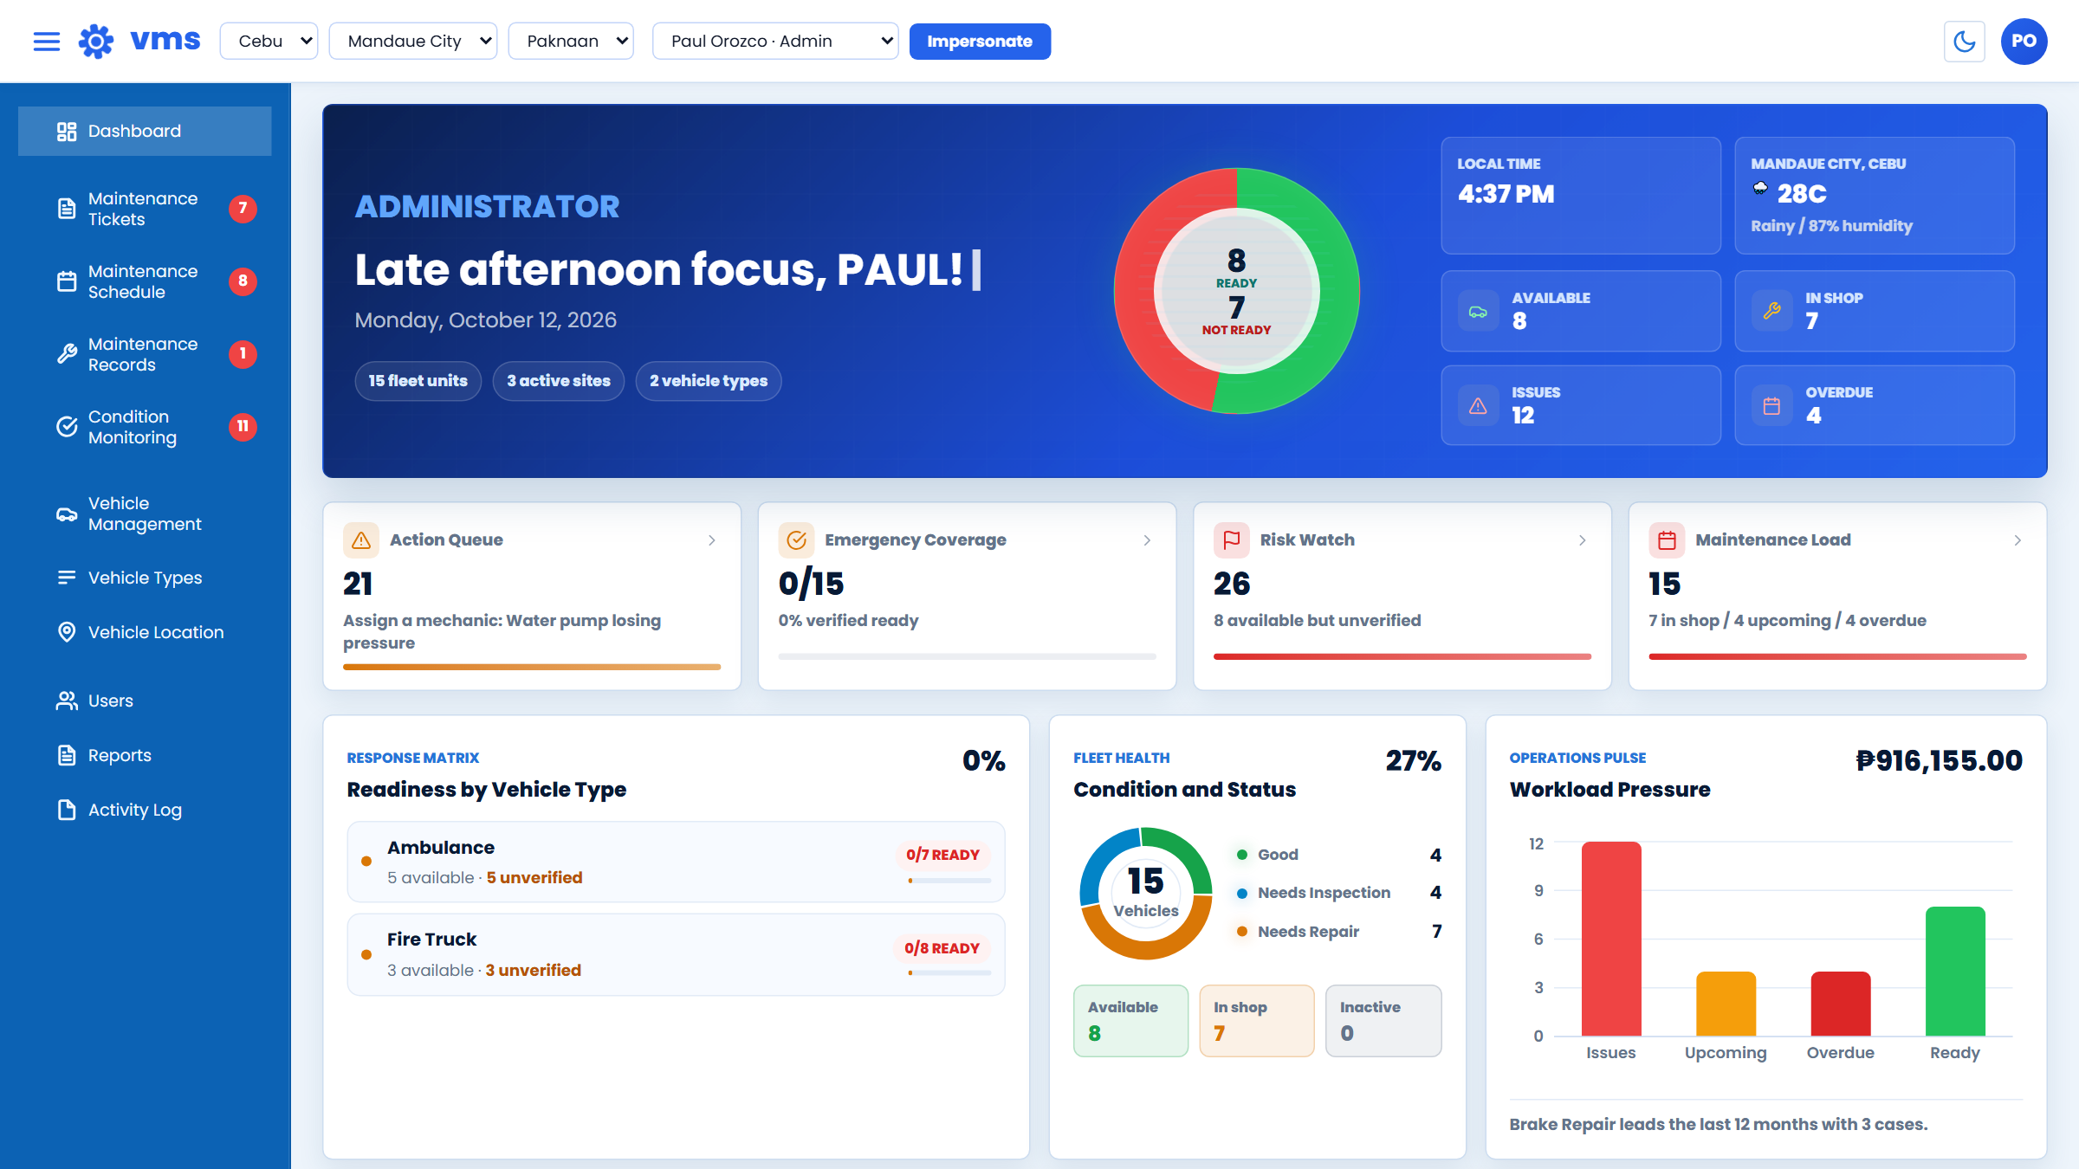


Admin dashboard
Live readiness of every vehicle
Action queue of what needs attention
Fleet health and workload at a glance
Notes:
Screenshot of the running system with demo data.

Slide 15
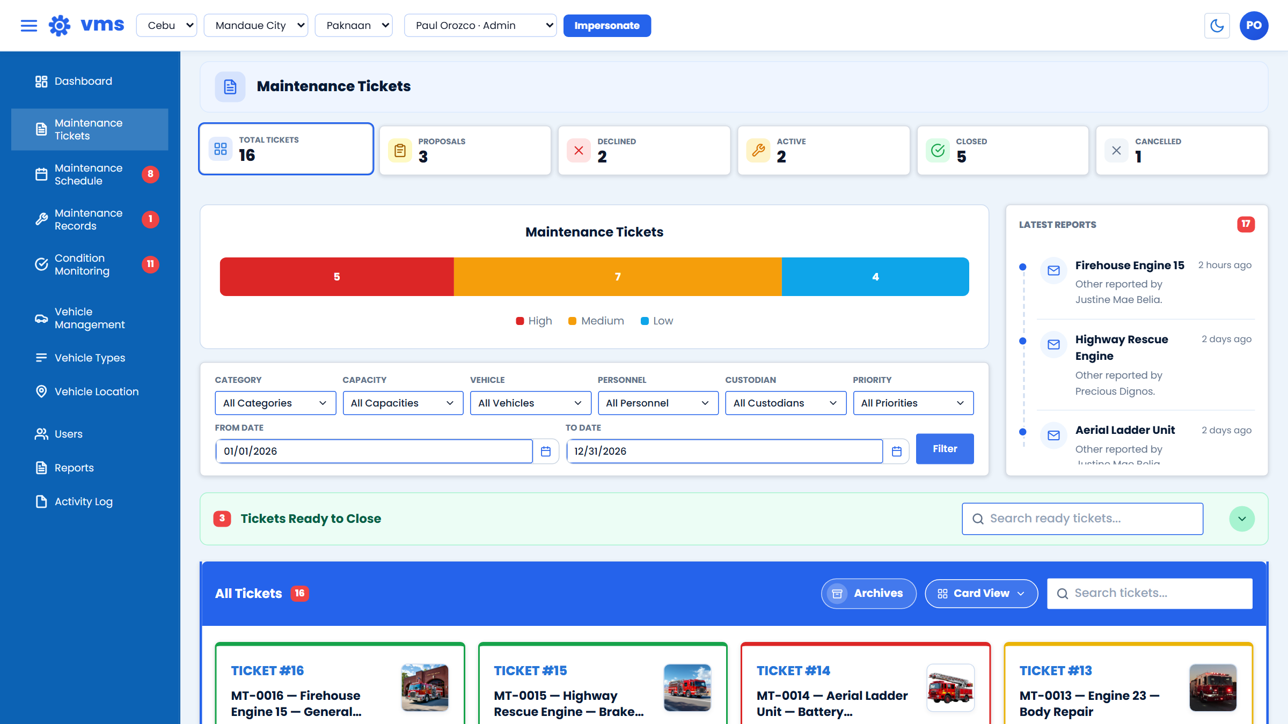


Ticket management
Every ticket as a status-coloured card
Filter by vehicle, personnel and priority
Sidebar badges flag new work
Notes:
Screenshot of the running system with demo data.

Slide 16
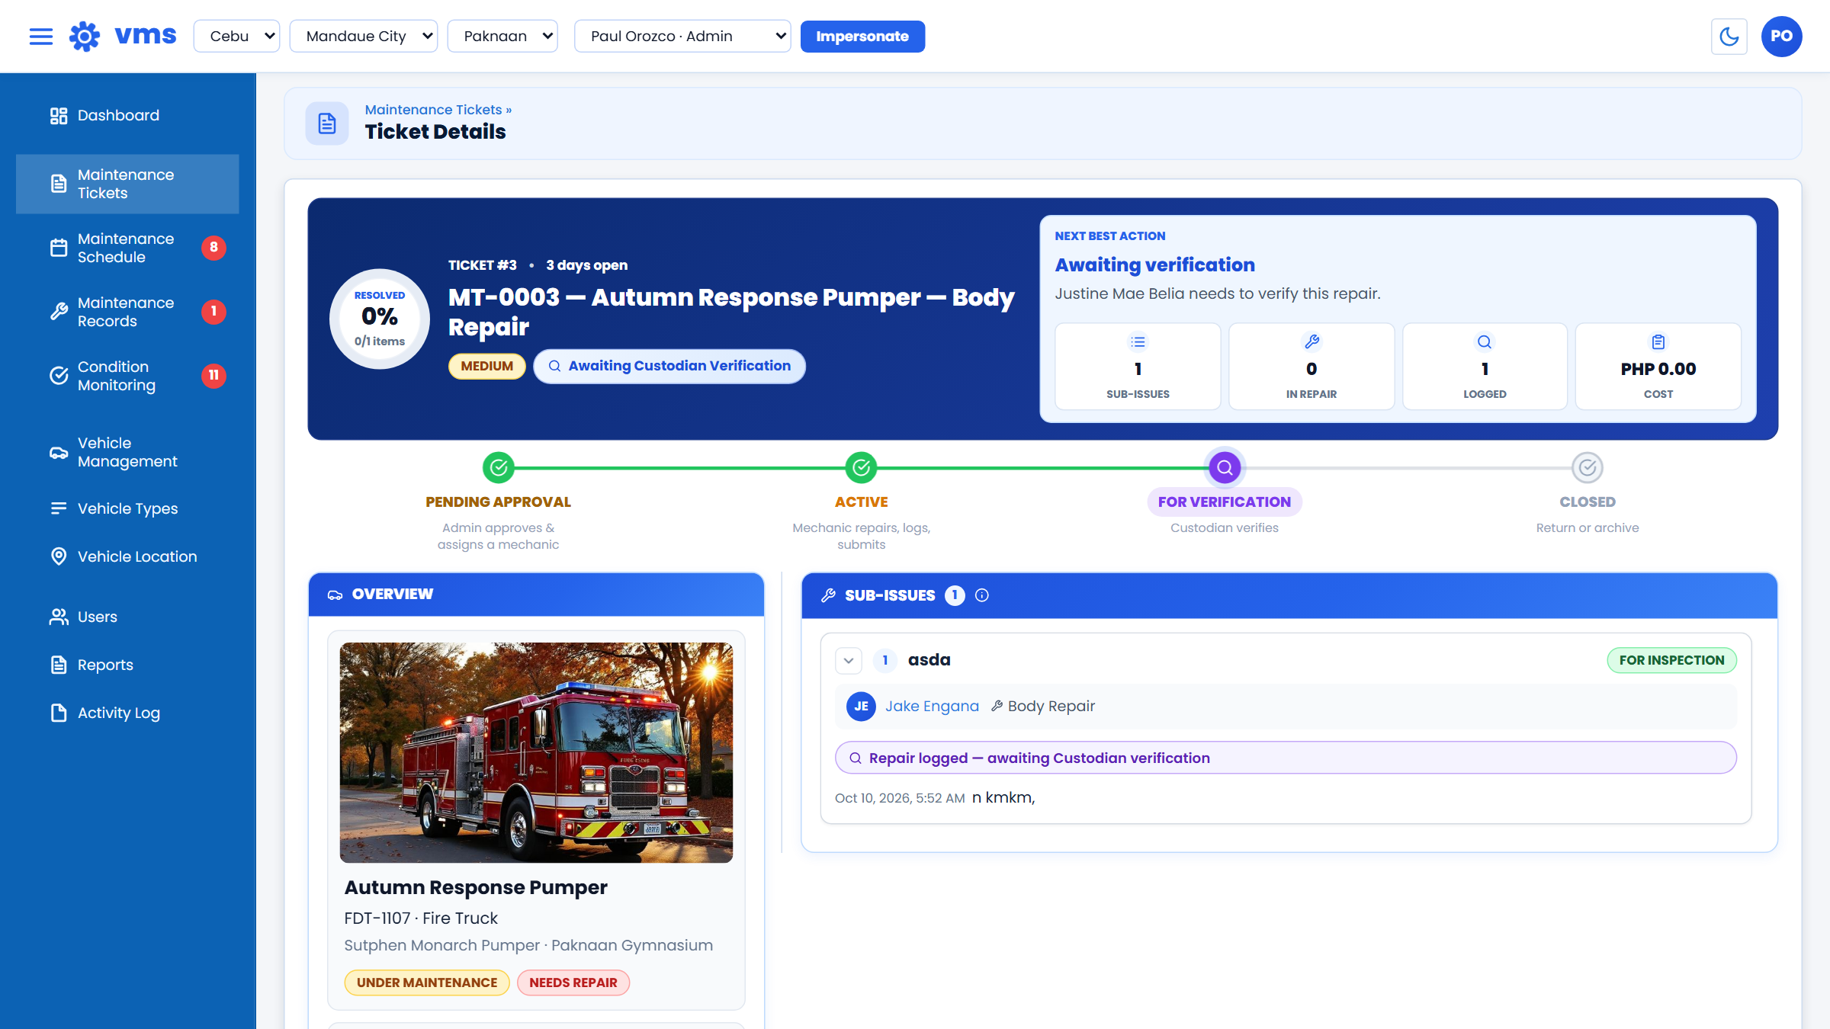


Ticket details
Four-stage progress tracker
Named people at every step
Full history kept on the ticket
Notes:
Screenshot of the running system with demo data.

Slide 17
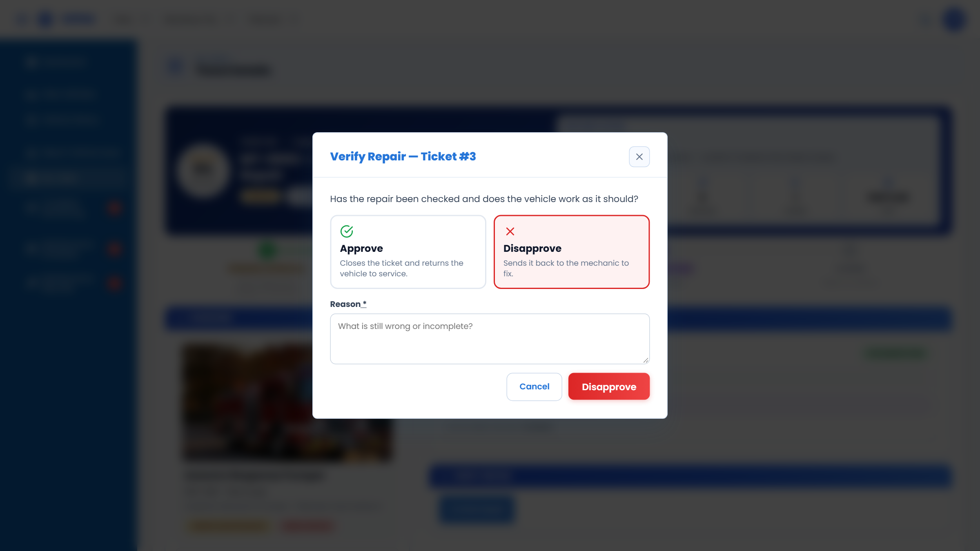

Independent verification
Approve to close the ticket
Disapprove with a required reason
Only the assigned Custodian can verify
Notes:
Screenshot of the running system with demo data.

Slide 18
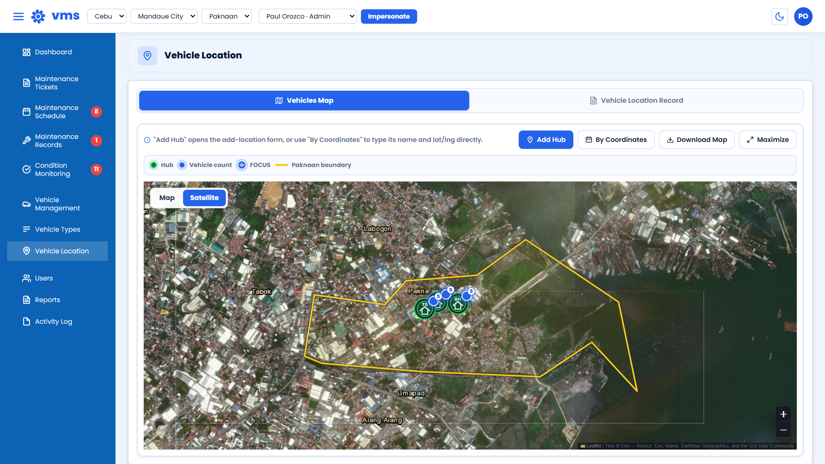

Vehicle location
Hubs on a satellite or street map
Barangay boundary overlay
Vehicles grouped by hub
Notes:
Screenshot of the running system with demo data.

Slide 19
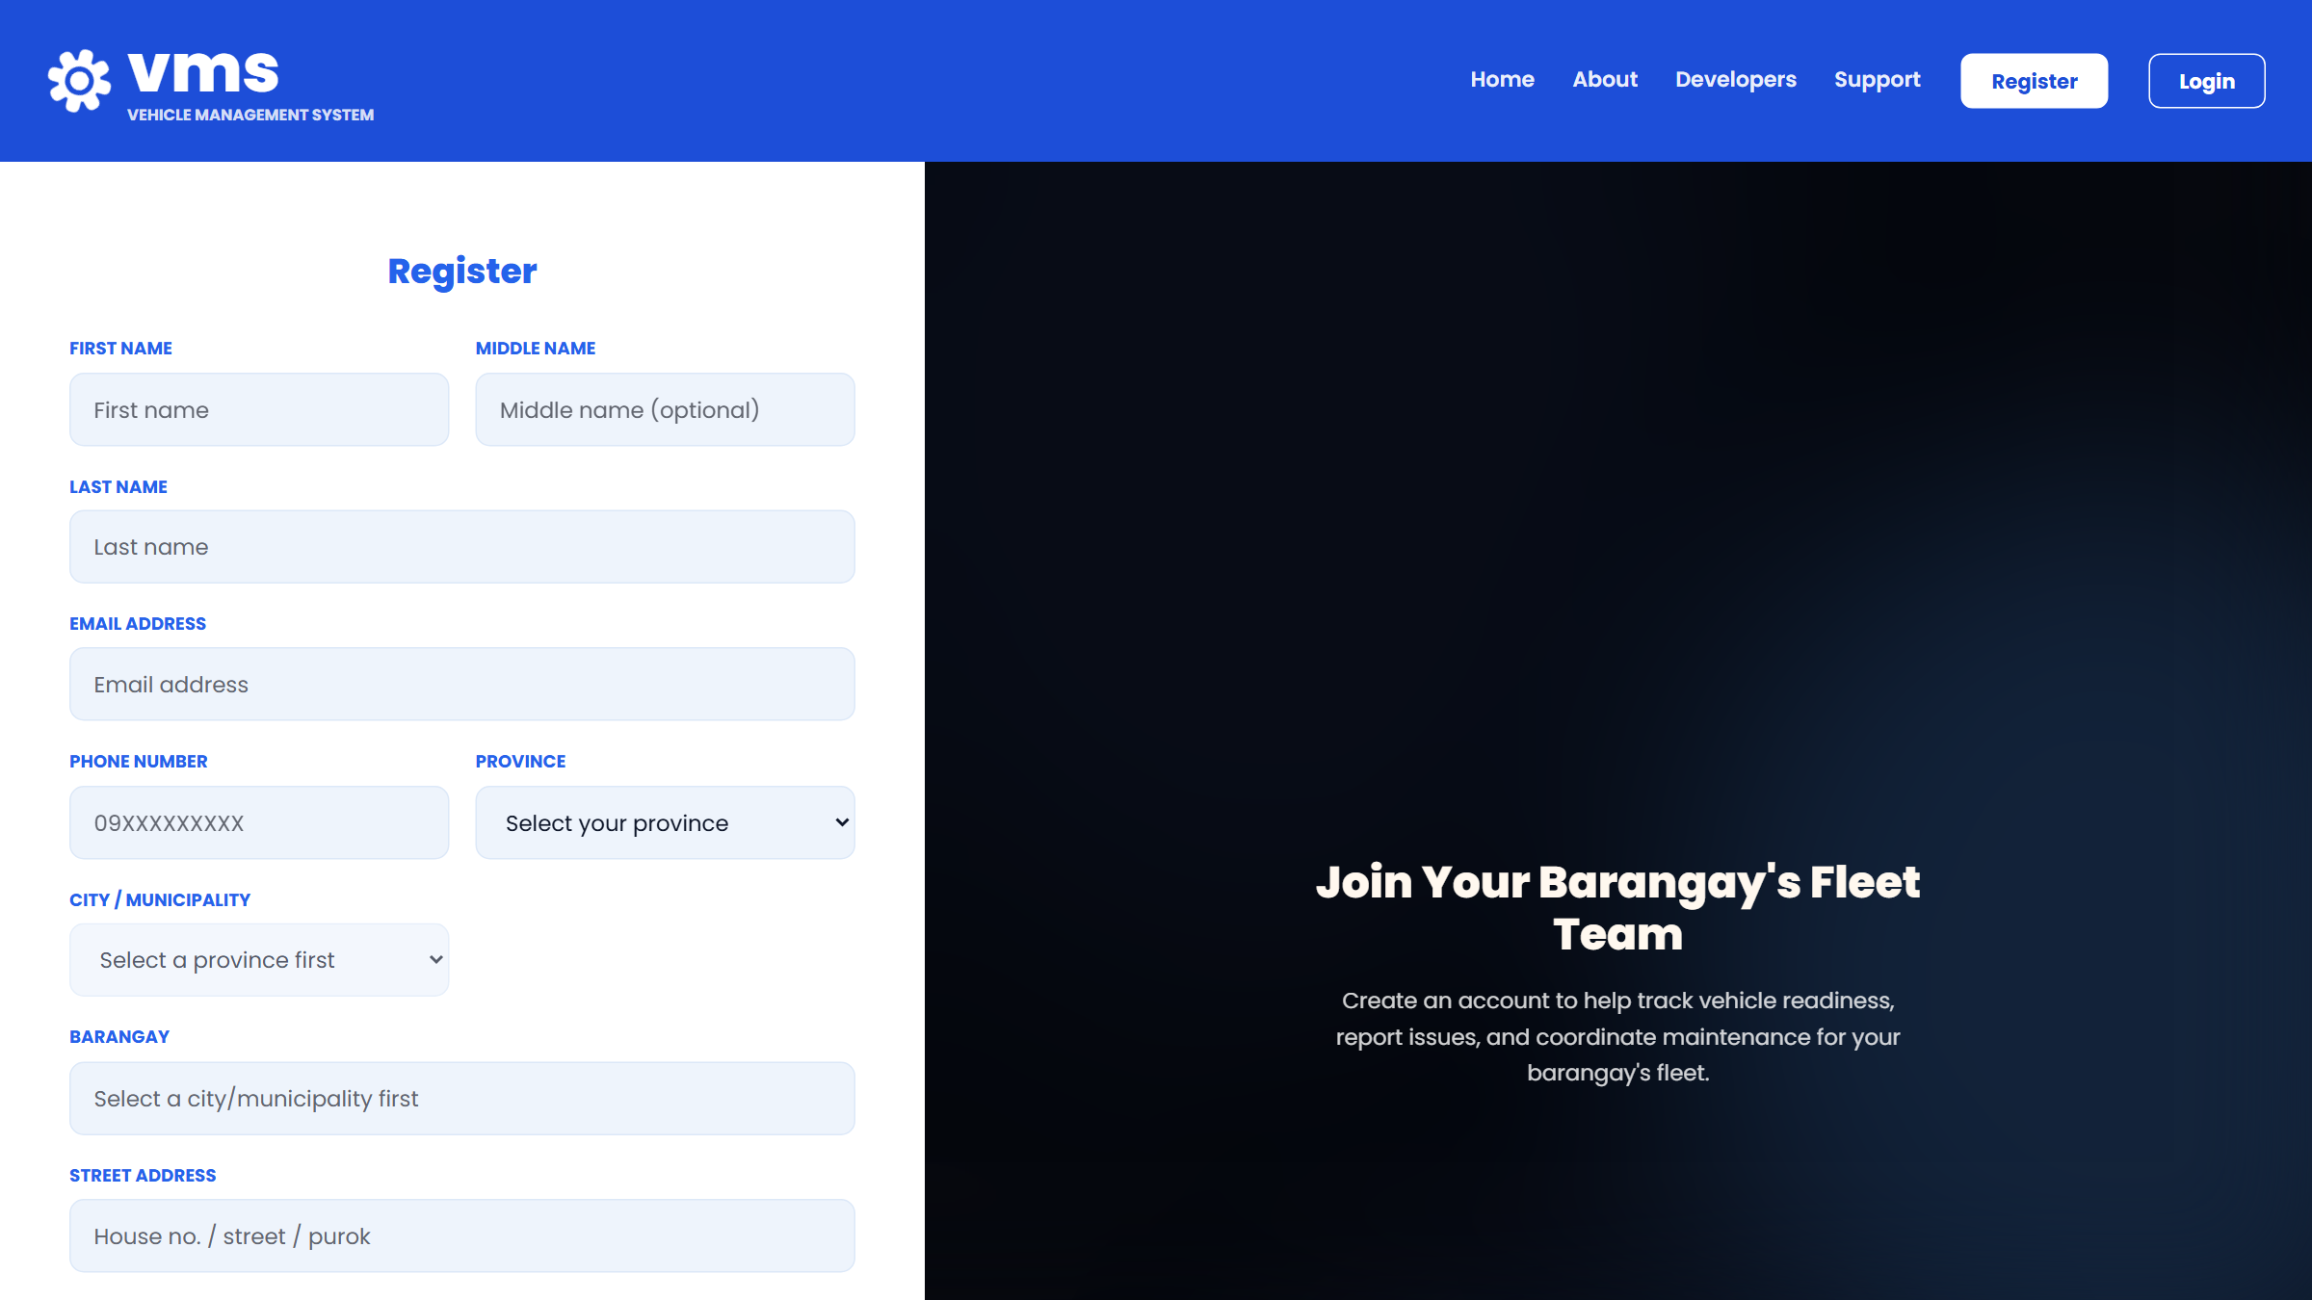
Security and registration
Three gates before anyone gets in
1
Barangay staff code
Issued by the barangay office, checked on the server
2
Human approval
Super Admin for a first Admin; the barangay Admin for everyone else
3
Barangay-scoped access
Every query is limited to that barangay
Also: no self-verification, last-Admin protection, rate limiting, audit log.
Notes:
Registration is the most sensitive entry point, so it has three independent gates. The account stays inactive until a human approves it.

Slide 20
Testing and quality
0
18
36
54
72
90
108
126
144
162
180
198
216
234
252
270
288
306
324
342
360
378
automated backend tests
Passing
0%
4%
8%
12%
16%
20%
24%
28%
32%
36%
40%
44%
48%
52%
56%
60%
64%
68%
72%
76%
80%
84%
88%
92%
96%
100%
378 of 378 pass: workflow, permissions, data scoping and validation.
Notes:
Test counts by area are grouped from the test classes. They cover the rules that matter most: who may do what, and what each barangay can see.

Slide 21
Results against the objectives
Track vehicles and readiness
Dashboard readiness view, 24-hour readiness checks, condition monitoring, location hubs and map.
Controlled ticket lifecycle
Proposal, Admin approval, mechanic repair, Custodian verification. 92 automated tests.
Role-based, separate data
Four roles, 103 permission abilities, per-barangay scoping. 137 automated tests on access and accounts.
Planning, reports and audit trail
Approved schedules with recurrence, 7 report types, notifications and an activity log.
Notes:
Each specific objective is matched to what was built and to automated tests.

Slide 22

Limitations and recommendations
Limitations
Recommendations
No email verification at sign-up; Admin approval is the identity check
No self-service password reset; an Admin resets it
Tracks availability, not live dispatch or GPS
Evaluated through automated tests and review passes
Add email verification and password reset
Build an installable mobile version
Send SMS alerts for urgent repairs
Add cost and downtime analytics
Notes:
Be upfront about the limits; each has a clear next step.

Slide 23
Conclusion
Visible readiness
Accountable repairs
Protected data
Staff can see which vehicles are ready, and why the others are not.
Every repair has a named proposer, approver, mechanic and verifier.
Gated registration, role permissions and per-barangay separation.
The study's objectives were met: the VMS helps keep emergency vehicles ready, and shows it.
Notes:
Close the loop with the problem statement: visibility, follow-through, accountability.

Slide 24
Thank you
Questions?

